Slide 1
Overview of the activities of ITU-T Focus Group on Smart Sustainable Cities
Cristina Bueti
Advisor, ITU-T Study Group 5
26 March 2015
itu.int/go/fgssc

Slide 2
Focus Group on Smart Sustainable Cities (FG SSC)
Established at ITU-T Study Group 5 meeting in Geneva in February 2013.
Lifetime: one year from the first meeting held on 8 May 2013. Extended to May 2015.
As an open platform for smart-city stakeholders to exchange knowledge in the interests of identifying the standardized frameworks needed to support the integration of ICT services in smart cities.
Participation is open to all.

Slide 3
Terms of reference (1/2)
Main tasks and deliverables:
Defining the role of ICTs in environmentally sustainable smart cities, and identifying the ICT systems necessary to their development;
Identifying or developing a set of key performance indicators (KPIs) to gauge the success of smart-city ICT deployments;
Establishing relationships and liaison mechanisms with other bodies engaged in smart-city studies and development;
Identifying future smart-city standardization projects to be undertaken by its parent group, ITU-T Study Group 5;
Developing a roadmap for the ICT sector’s contribution to smart sustainable cities, providing cohesion to the development and application of technologies and standards.

Slide 4
Terms of reference (2/2)
In collaboration with:
Within SG5: Q7, Q13, Q14, Q15, Q16, Q17, Q18, and Q19, etc.;
All ITU-T Study Groups, especially SG11, SG13, SG15, SG16 and SG17;
Other international, regional and national SDOs, such as ISO, IEC, IEEE, CEN/CENELEC, ETSI, etc.;
Relevant entities including: municipalities, federation of municipalities, non-governmental organizations (NGOs), policy makers, industry forums and consortia, companies, academic institutions, research institutions, etc.

Slide 5
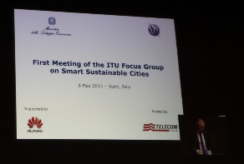
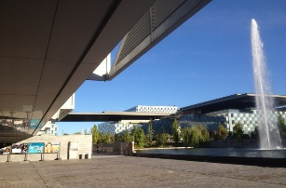
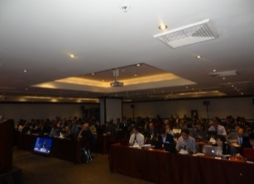
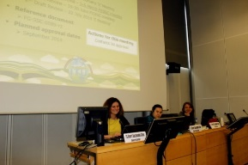
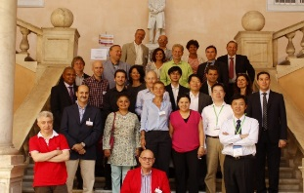
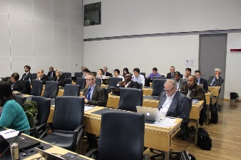
Past and upcoming meetings
1st meeting: Turin, 8 May 2013 (Telecom Italia) >50 participants
2nd meeting: Madrid, 17 Sept 2013 (Telefónica) >50 participants
3rd meeting: Lima, 6 Dec 2013 (Gov. of Peru) >60 participants
4th meeting: Geneva, 5-6 March 2014 (ITU) >30 participants
5th meeting: Genoa, 19-20 June 2014 (Genoa Municipality) >45 participants
6th meeting: Geneva, 13-16 Oct 2014 (ITU) >50 participants
7th meeting: Reading, 4-6 Mar 2015 (Symantec) >40 participants
8th meeting: United Arab Emirates, 5-6 May 2015

Slide 6
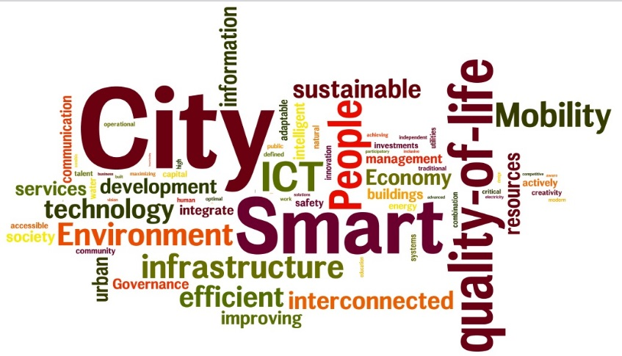
FG-SSC agreed definition of a smart sustainable city
“A smart sustainable city is an innovative city that uses information and communication technologies (ICTs) and other means to improve quality of life, efficiency of urban operation and services, and competitiveness, while ensuring that it meets the needs of present and future generations with respect to economic, social and environmental aspects.”

Slide 7
FG-SSC Working Groups
ICT role and roadmap for smart sustainable cities
Smart sustainable cities infrastructure
1
2
Policy and positioning
KIPs and metrics for smart sustainable cities
4
3

Slide 8
Working Group 1
ICT role and roadmap for smart sustainable cities
1

Slide 9
TR1/WG1 Technical Report on overview of smart sustainable cities and the role of ICT
Objective | To provide an overview of a SSC and establish what the role of ICT is in relation to such an urban environment.
Highlights | This report describes the main attributes of a smart and sustainable city (SSC) and provides readers with a better understanding of what constitutes an SSC. It identifies the role and potential of Information and Communication Technologies (ICTs) in an SSC and outlines at a high level, the key ICT infrastructures which will enable SSC strategies.
Status | Finalized in October 2014 and approved in December 2014 by ITU-T Study Group 5
Free download | itu.int/en/ITU-T/focusgroups/ssc/Documents/Approved_Deliverables/TR-Overview-SSC.docx

Slide 10
TR2/WG1 Technical Report on smart sustainable cities: an analysis of definitions
Objective | To provide a basis for understanding the most common features of SSC.
Highlights | Analyses over 120 different definitions of SSC; Makes a proposal for a comprehensive definition for SSC as part of the work conducted by WG1.
Status | Finalized in October 2014 and approved in December 2014 by ITU-T Study Group 5
Free download | itu.int/en/ITU-T/focusgroups/ssc/Documents/Approved_Deliverables/TR-Definitions.docx

Slide 11
TR3/WG1 Technical Report on the city we want: a guide for city leaders
Objective | A high-level policy document aimed at the mayors/high-level policy makers at the municipal level: Describing the key challenges faced by cities, what technologies can do to help tackle those challenges, and what are key priorities for action; Showcasing that the SSC vision is realizable.

Slide 12
TR4/WG1 Technical Report on the city we want: a master plan for smart sustainable cities
Objective | A methodology document, aimed at providing an overview of the path for cities to become SSC: The document aims at decision makers and practitioners within the municipalities or government bodies involved in SSC planning and implementation; Includes stages such as setting the SSC vision, master plan, roadmap, deployment and follow-up.
12

Slide 13
TR5/WG1 Technical Report on developing a framework for evaluating the impacts of a smart sustainable city
Objective | This Technical Report aims at helping cities to engage with and make decisions that impact multiple stakeholders and overcome organisational and logistical boundaries.
13

Slide 14
Working Groups 2
Smart sustainable cities infrastructure
2

Slide 15
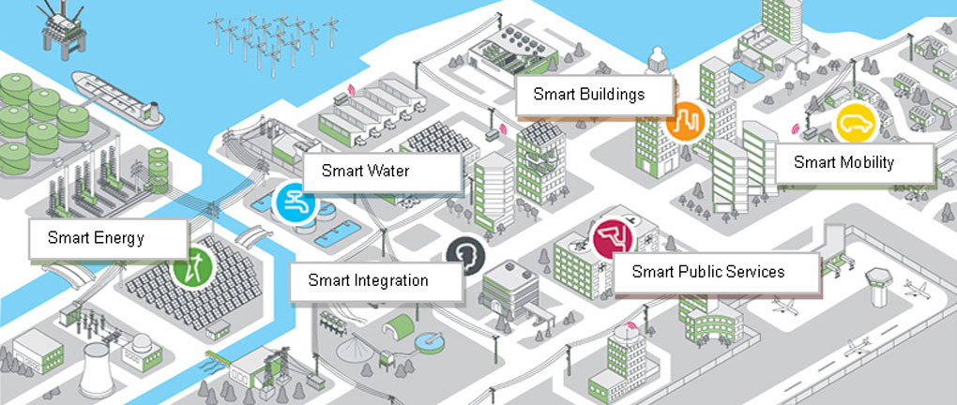
Areas of WG2 Technical Reports
Open Data
Integrated Management
Smart Buildings
Smart Water Management
Smart Infrastructure
Climate Change Adaptation
Cyber-Security and Resilience
EMF considerations

Slide 16
TR1/WG2 Technical Report on smart water management in cities
Objective | Smart water management (SWM) in cities seeks to alleviate challenges in the urban water management and water sector through the incorporation of Information and Communication Technologies (ICTs) products, solution and systems in areas of water management and sanitation.
Status | Finalized in October 2014 and approved in December 2014 by ITU-T Study Group 5
Free download | itu.int/en/ITU-T/focusgroups/ssc/Documents/Approved_Deliverables/TR-SWM-cities.docx

Slide 17
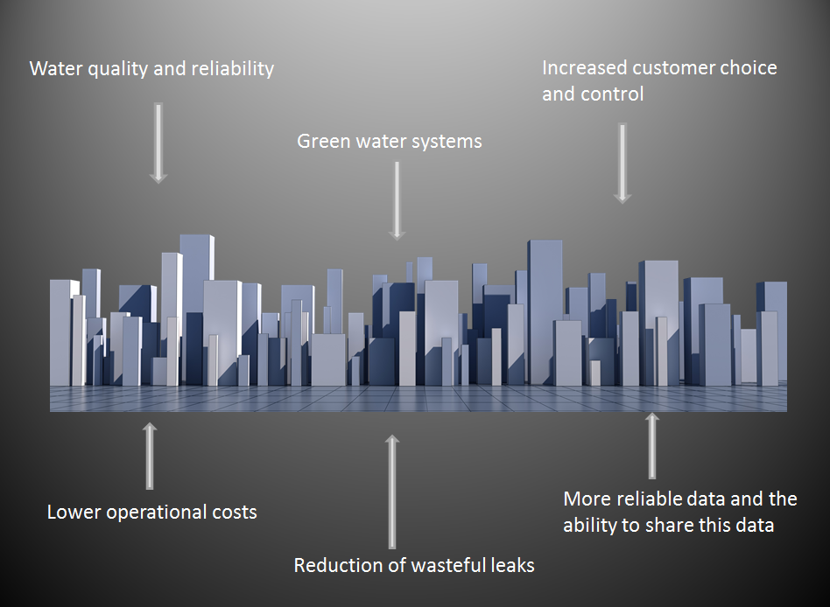
TR1/WG2 Technical Report on smart water management in cities
SWM technologies:
Sensors and sensor networks
Smart pipes
Smart metering
Communication modems
Geographic information systems (GIS)
Cloud computing
Supervisory control and data management (SCADA)
Models, optimization tools and decision support
Web-based communication and information system tools
SWM integration:
Intelligent solutions in urban water management
Remote monitoring solutions to urban wastewater management technologies for urban flood management
System tools

Slide 18
TR2/WG2 Technical Report on EMF considerations in smart sustainable cities
Objective | Introduction to SSC and importance of ICT’s and EMF considerations; Based on existing ITU and WHO technical and policy recommendations; Technical and policy requirements for EMF should be adopted nationally based on international recommendations; Cities need guidance on implementation that promotes efficient deployment; Provides a model framework as benchmark. Smart Sustainability City EMF Checklist
Status | Finalized in October 2014 and approved in December 2014 by ITU-T Study Group 5
Free download | itu.int/en/ITU-T/focusgroups/ssc/Documents/Approved_Deliverables/TR-EMF.docx

Slide 19
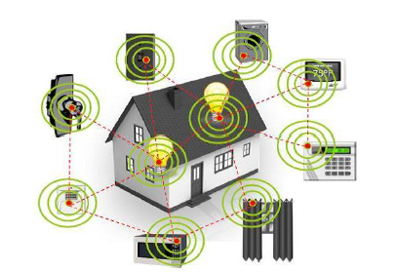
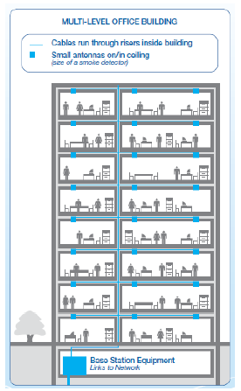
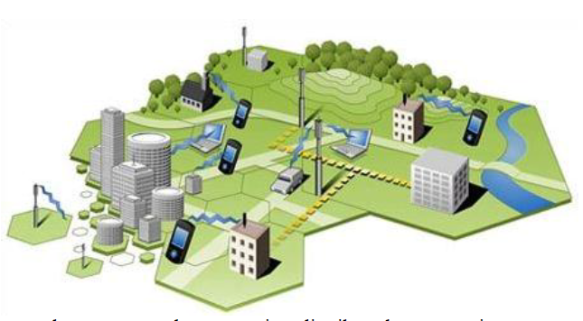
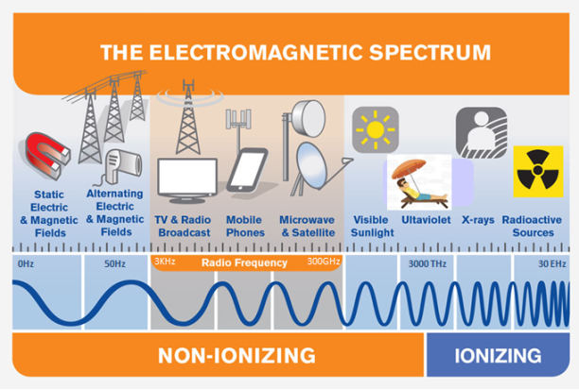
TR2/WG2 Technical Report on EMF considerations in smart sustainable cities
Document key features:
It provides guidance on implementation, and promotes efficient deployment of wireless networks in smart sustainable cites.
It features a “smart sustainability city EMF checklist” designed to provide an easy to use reference for city officials and planners to ensure smart city policies operate most efficiently and comply with EMF exposure standards.
ICT’s connecting our world

Slide 20
TR3/WG2 Technical Report on ICTs for climate change adaptation in cities
Objective | Describes in general terms the impacts of climate change in cities and highlights the reasons for cities to improve their capacity to respond to the challenges posed by climate change; Further expands by identifying the role of ICTs in helping cities to adapt to climate change.
Status | Finalized in March 2015

Slide 21
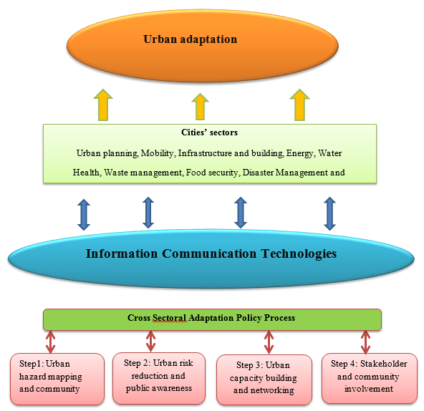
TR3/WG2 Technical Report on ICTs for climate change adaptation in cities
Framework for ICTs’ integration in urban adaptation to assist policy makers in developing effective adaptation strategies and building resilient cities.

Slide 22
TR4/WG2 Technical Report on cybersecurity, data protection and cyber resilience in smart sustainable cities
Objective | Explores the requirements and challenges of creating a secure, reliable and resilient smart city; Considers how to provide innovative, resilient “smart” solutions that leverage digital information while protecting against malicious violations, unintentional damage and natural disasters.
Status | Finalized in March 2015

Slide 23
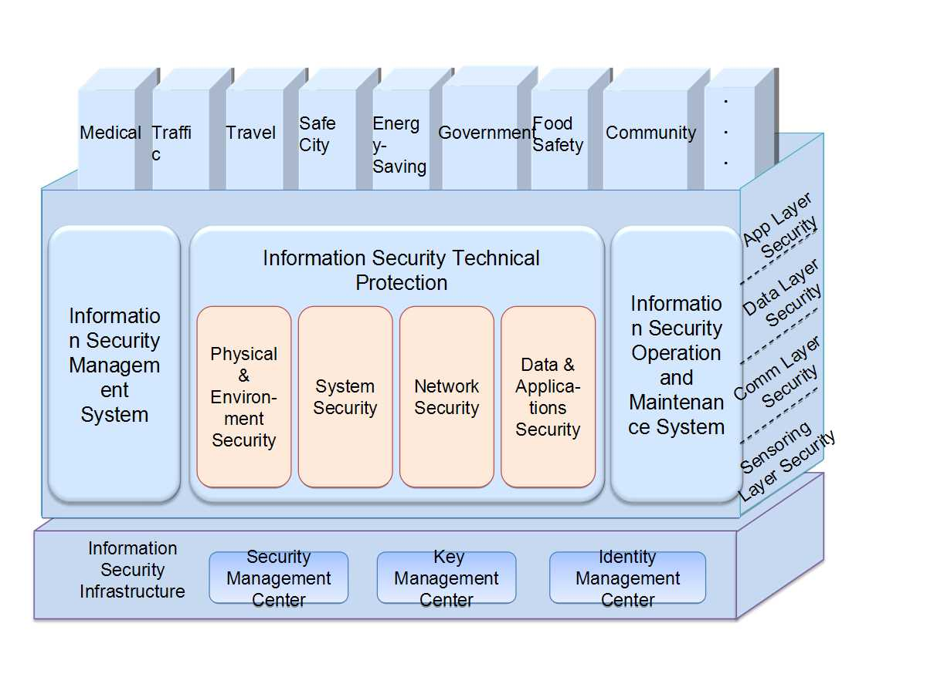
TR4/WG2 Technical Report on cybersecurity, data protection and cyber resilience in smart sustainable cities
Security architecture of a SSC: smart city information security system provides security for smart city from technology and management.
Notes:
On the basis of security infrastructure, smart city information security system provides security for smart city from technology and management. Establish a comprehensive security system from the four directions of physical and environmental security, system security, network security, and data and application security on technical level. Aiming at each layer's unique security risks of sensing layer, communication layer, data layer and application layer, implement appropriate solutions respectively, to achieve prevention and control of smart city layer upon layer. Protect the whole construction system and safeguard the security of smart city.
23

Slide 24
TR5/WG2 Technical Report on overview of smart sustainable cities infrastructure
Objective | Provides a technical overview on infrastructure related to ICT to develop a SSC; ICT can provide intelligence to traditional infrastructure, turning it into smart infrastructure; Two aspects to be considered: the deployment of new ICT infrastructure and the improvement of the current infrastructure; ICT acts as an enabler to build SSC that use resources efficiently, cut energy costs, foster energy savings, improve quality of life, and reduce environmental footprint.

Slide 25
TR6/WG2 Technical Specifications on ICT architecture of smart sustainable cities
Objective | These technical specifications describe architecture and technical requirements of SSC: Concepts, coverage, vision and use cases of smart and sustainable cities; Characteristics and requirements of smart and sustainable cities; Efficient services and network infrastructure of smart and sustainable cities, as well as its architectural framework from the environmental impact point of view.

Slide 26
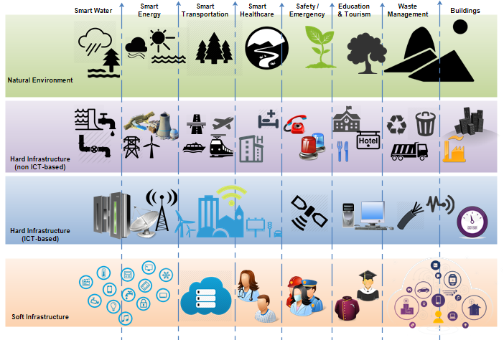
TR6/WG2 Technical Specifications on ICT architecture of smart sustainable cities
The architecture of the SSC is expected be multi-tier

Slide 27
TR7/WG2 Technical Specifications on multi-service infrastructure for smart sustainable cities in new-build areas
Objective | This document focuses on answering the question “How should ICT infrastructure be planned for a new city given that it has to be both smart and sustainable?”. The ICT infrastructure can then be planned and a set of technical requirements can be drawn up. After that, relevant specifications can be written, drawing upon the wealth of existing ICT specifications and standards. If new specifications are needed for the “new-city-build” scenario, these will be identified. The approach taken assumes that no infrastructure exists and the city is to be built from new.

Slide 28
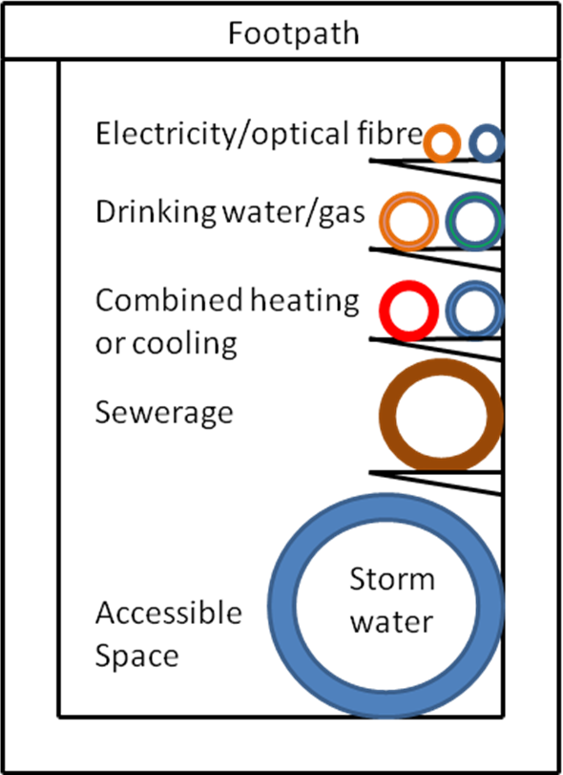
TR7/WG2 Technical Specifications on multi-service infrastructure for smart sustainable cities in new-build areas
Example of possible duct infrastructure for SSC (side-view).

Slide 29
TR8/WG2 Technical Report on smart buildings for smart sustainable cities
Objective | Defines a smart / intelligent building in the context of SSC; Survey of current initiatives around building resiliency; Outline of potential resiliency protocol.
Document outline:
Definition – How to define a smart / intelligent building in the context of SSC
Current applicable standards / initiatives
Gap analysis of current standards / initiatives
Roadmap of standards required
Recommendations for further work

Slide 30
TR9/WG2 Technical Report on integrated management for smart sustainable cities
Objective | The integrated management for SSC is to integrate and process the people, events, things and the corresponding information streams intelligently: access and integration of city information resources; network service of the model of city analysis and decision-making; typical applications of comprehensive management and smart decision-making.
Status | Finalized in March 2015

Slide 31
TR9/WG2 Technical Report on integrated management for smart sustainable cities
The framework of integrated management for SSC includes the organization of the resource management standards under the smart city environment.
Node Metadata Standard
Observation Process Metadata
Standard
Resources integration
Observation Metadata Standard
standards
Model Metadata Standard
Event Metadata Standard
Technical Specification for
Integrated smart
Fusion processing
technical specifications
Resource and Toponym Matching
city management
standards
Technical Specification for
Resource and Map Fusion
Data Service Interface
Specification
Management service
Model Service Interface
technical specifications
Specification
Event Service Interface
Specification
Notes:
The integrated management for SSC is to integrate and process the people, events, things and the corresponding information streams intelligently. In this report, the framework of the integrated management for smart sustainable cities is proposed, including the resources integration standards (Node meta-model, observation process meta-model, observation data meta-model, event meta-model, and model meta-model), fusion processing workflow (Fusion of resources and toponym, images, and maps separately), and service interface specification (Observation service, model service, and event service).
31

Slide 32
TR10/WG2 Technical Report on anonymization infrastructure and open data for smart sustainable cities
Objective | Proposes a summarized introduction on open data in smart sustainable cities and characterize open data in smart sustainable cities in seven aspects: demand of open data in SSC, framework of open data in SSC, constraint of open data in SSC, technology of open data in SSC, management of open data in SSC, use cases, solutions. Provides guidance on implementation, and promotes efficient deployment of open data in smart sustainable cities.

Slide 33
Working Groups 3
KIPs and metrics for smart sustainable cities
3

Slide 34
TR1/WG3 Technical Report on standardization roadmap for smart sustainable cities
Objective | This technical report proposes a framework of standards for SSC and provides a standardization roadmap, taking into consideration the activities currently undertaken by the various SDOs and forums; It also tries to identify the areas where there is lack of standards and how to fill the gap, providing the basis for a wider standardization roadmap.
Status | Finalized in March 2015

Slide 35
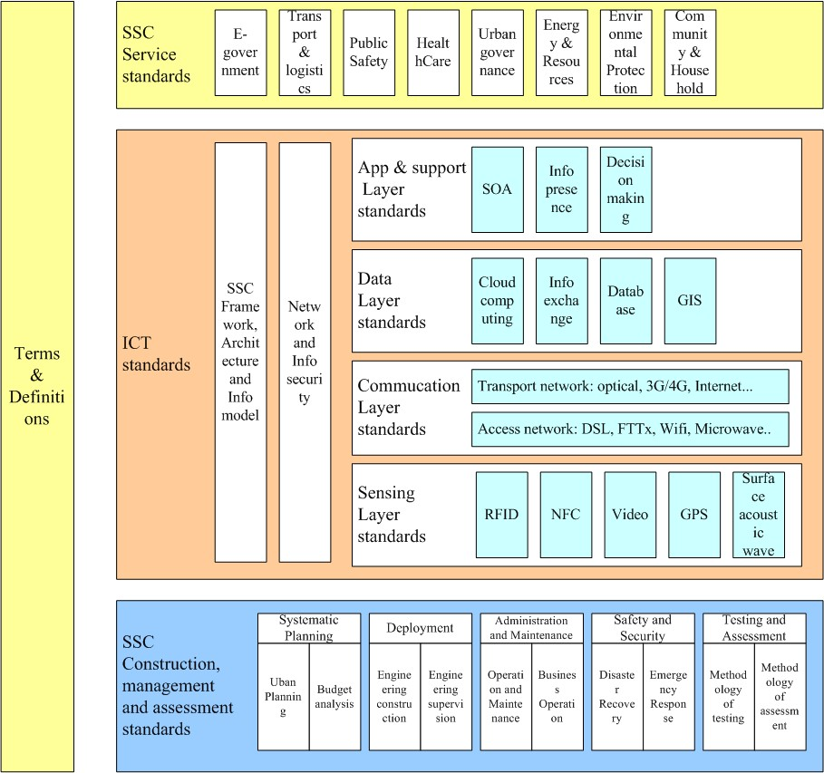
TR1/WG3 Technical Report on standardization roadmap for smart sustainable cities
Framework of SSC standards based on three categories

Slide 36
TR2/WG3 Technical Report on standardization activities for smart sustainable cities
Objective | This technical report provides an overview of the activities related to SSC currently undertaken by the various SDOs and forums. Areas covered: SSC terminology standards SSC services standards ICT standards SSC management and assessment standards Building and physical infrastructure standards

Slide 37
TR3, 4, 5, & 6/WG3 KPIs series
Objective:
Identify or develop a set of key performance indicators (KPIs) to assess how the use of ICTs has an impact on the environmental sustainability of cities.
Develop a document which contains a set of KPIs to assess the impact of the use of ICT projects in cities.

Slide 38
TR3, 4, 5, & 6/WG3 KPIs series
Title | Technical Specifications on overview of key performance indicators in smart sustainable cities
Status | Finalized in October 2014 and approved in December 2014 by ITU-T Study Group 5
Free download | itu.int/en/ITU-T/focusgroups/ssc/Documents/Approved_Deliverables/TS-Overview-KPI.docx
Title | Technical Specifications on key performance indicators related to the use of information and communication technology in smart sustainable cities
Status | Finalized in March 2015
Title | Technical Specifications on key performance indicators related to the sustainability impacts of information and communication technology in smart sustainable cities
Status | Finalized in March 2015
Title | Technical Report on key performance indicators definitions for smart sustainable cities
Status | Finalized in March 2015

Slide 39


KPIs for smart sustainable cities
Rationale:
To assess how the use of ICTs could have an impact on the sustainability of cities to provide a ground for standardization.
Benefits for:
City residents and nonprofit citizen organizations, enabling them to understand the development and progress of SSC with respect to ICT’s impact;
Development and operation organizations of SSC, including planning unit, SSC-related producers and service providers, operation and maintenance organizations, helping them to fulfill the tasks of sharing information related to the use of ICT and its impact on the sustainability of cities;
Evaluation and ranking agencies, including academia, supporting them in selection of relevant KPIs for assessing the contribution from ICT in the development of SSC.

Slide 40

KPIs for smart sustainable cities
dimension | indicators
ICT | 14, covering Network facilities, Information facilities
Environmental sustainability | 14, covering Environment, Energy and natural resources
Productivity | 12, covering Innovation, Economy sustainability
Quality of life | 22, covering Convenience and comfort, Security and safety, Healthcare, Education and training
Equity and social inclusion | 11, covering Openness and public participation, Social sustainability, Governance sustainability
Non-ICT infrastructure development | 15, covering Building, Transport, Sanitation, Municipal pipe network

Slide 41
Working Groups 4
Policy and positioning
4

Slide 42
TR1/WG4 Technical Report on engaging stakeholders for smart sustainable cities
Objective | Smart sustainable cities overview and challenges. Methodology for stakeholders identification. Stakeholder analysis and roles. Guidance to SSC stakeholders to drive SSC.
Status | Finalized in March 2015

Slide 43

TR1/WG4 Technical Report on engaging stakeholders for smart sustainable cities
SSC stakeholders:
Municipalities and city administration (including different departments).
Urban planners
National and regional governments.
City services companies and utility providers.
ICT companies (Telecom operators, start-ups, software companies)
NGOs
Multilateral Organizations
Industry associations
Academia and scientific community
Citizens and citizen organizations
Standardization Bodies
Objective:
To help stakeholders identify their roles in the development of the SSC and within SSC

Slide 44
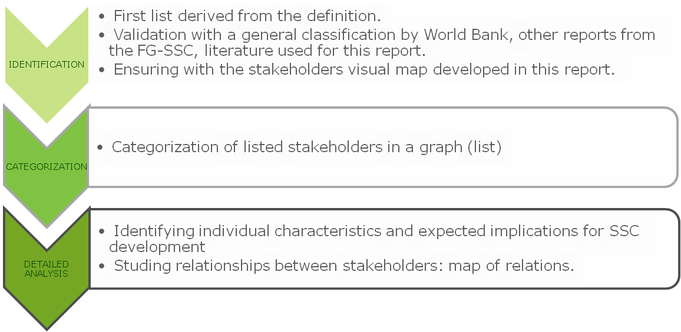
TR1/WG4 Technical Report on engaging stakeholders for smart sustainable cities
Steps for stakeholders analysis:

Slide 45
To summarize
FG on Smart Sustainable Cities was established in February 2013 and will end in May 2015.
4 Working Groups have been created :
ICT role for smart sustainable cities
Smart sustainable cities infrastructure
Standardization gaps, KPIs and metrics
Policy and positioning (communications, liaisons and members)
The FG-SSC has agreed upon the following definition for a Smart Sustainable City
Considerable liaison activities are underway with a host of other SDOs and organizations including ISO, IEC, IEEE, ETSI, EC DG Connect, UNECE, UNU, StEP, CEDARE, UNESCO, UN-Habitat, WMO, UNEP and UNFCCC.

Slide 46
To summarize (continued)
At its sixth meeting in October 2014, the FG SSC finalized the following technical reports and specifications approved by SG5 in December 2014:
Technical Report on overview of smart sustainable cities and the role of information and communication technology
Technical Report on smart sustainable cities: an analysis of definitions
Technical Report on smart water management in cities
Technical Report on electromagnetic field (EMF) considerations in smart sustainable cities
Technical Specifications on overview of key performance indicators in smart sustainable cities

Slide 47
To summarize (continued)
At its seventh meeting in March 2015, FG-SSC finalized and agreed on other deliverables as follows:
Technical Report on Information and communication technologies for climate change adaptation in cities
Technical Report on Cybersecurity, data protection and cyber resilience in smart sustainable cities
Technical Report on Integrated management for smart sustainable cities
Technical Report on Key performance indicators definitions for smart sustainable cities
Technical specifications on Key performance indicators related to the use of information and communication technology in smart sustainable cities
Technical specifications on Key performance indicators related to the sustainability impacts of information and communication technology in smart sustainable cities
Technical Report on Standardization roadmap for smart sustainable cities
Technical Report on Setting the stage for stakeholders’ engagement in smart sustainable cities
Other 9 deliverables are under development.

Slide 48
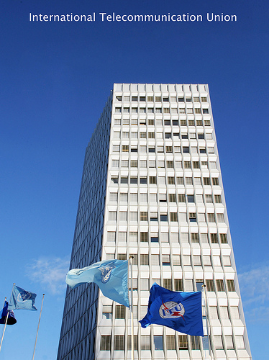
THANK YOU
ITU-T FG-SSC itu.int/go/fgssc
ITU-T and Climate Change itu.int/go/ITU-T/climate
ITU Symposia & Events on ICTs and Climate Change itu.int/en/ITU-T/climatechange/Pages/events.aspx
tsbfgssc@itu.int

